Slide 1
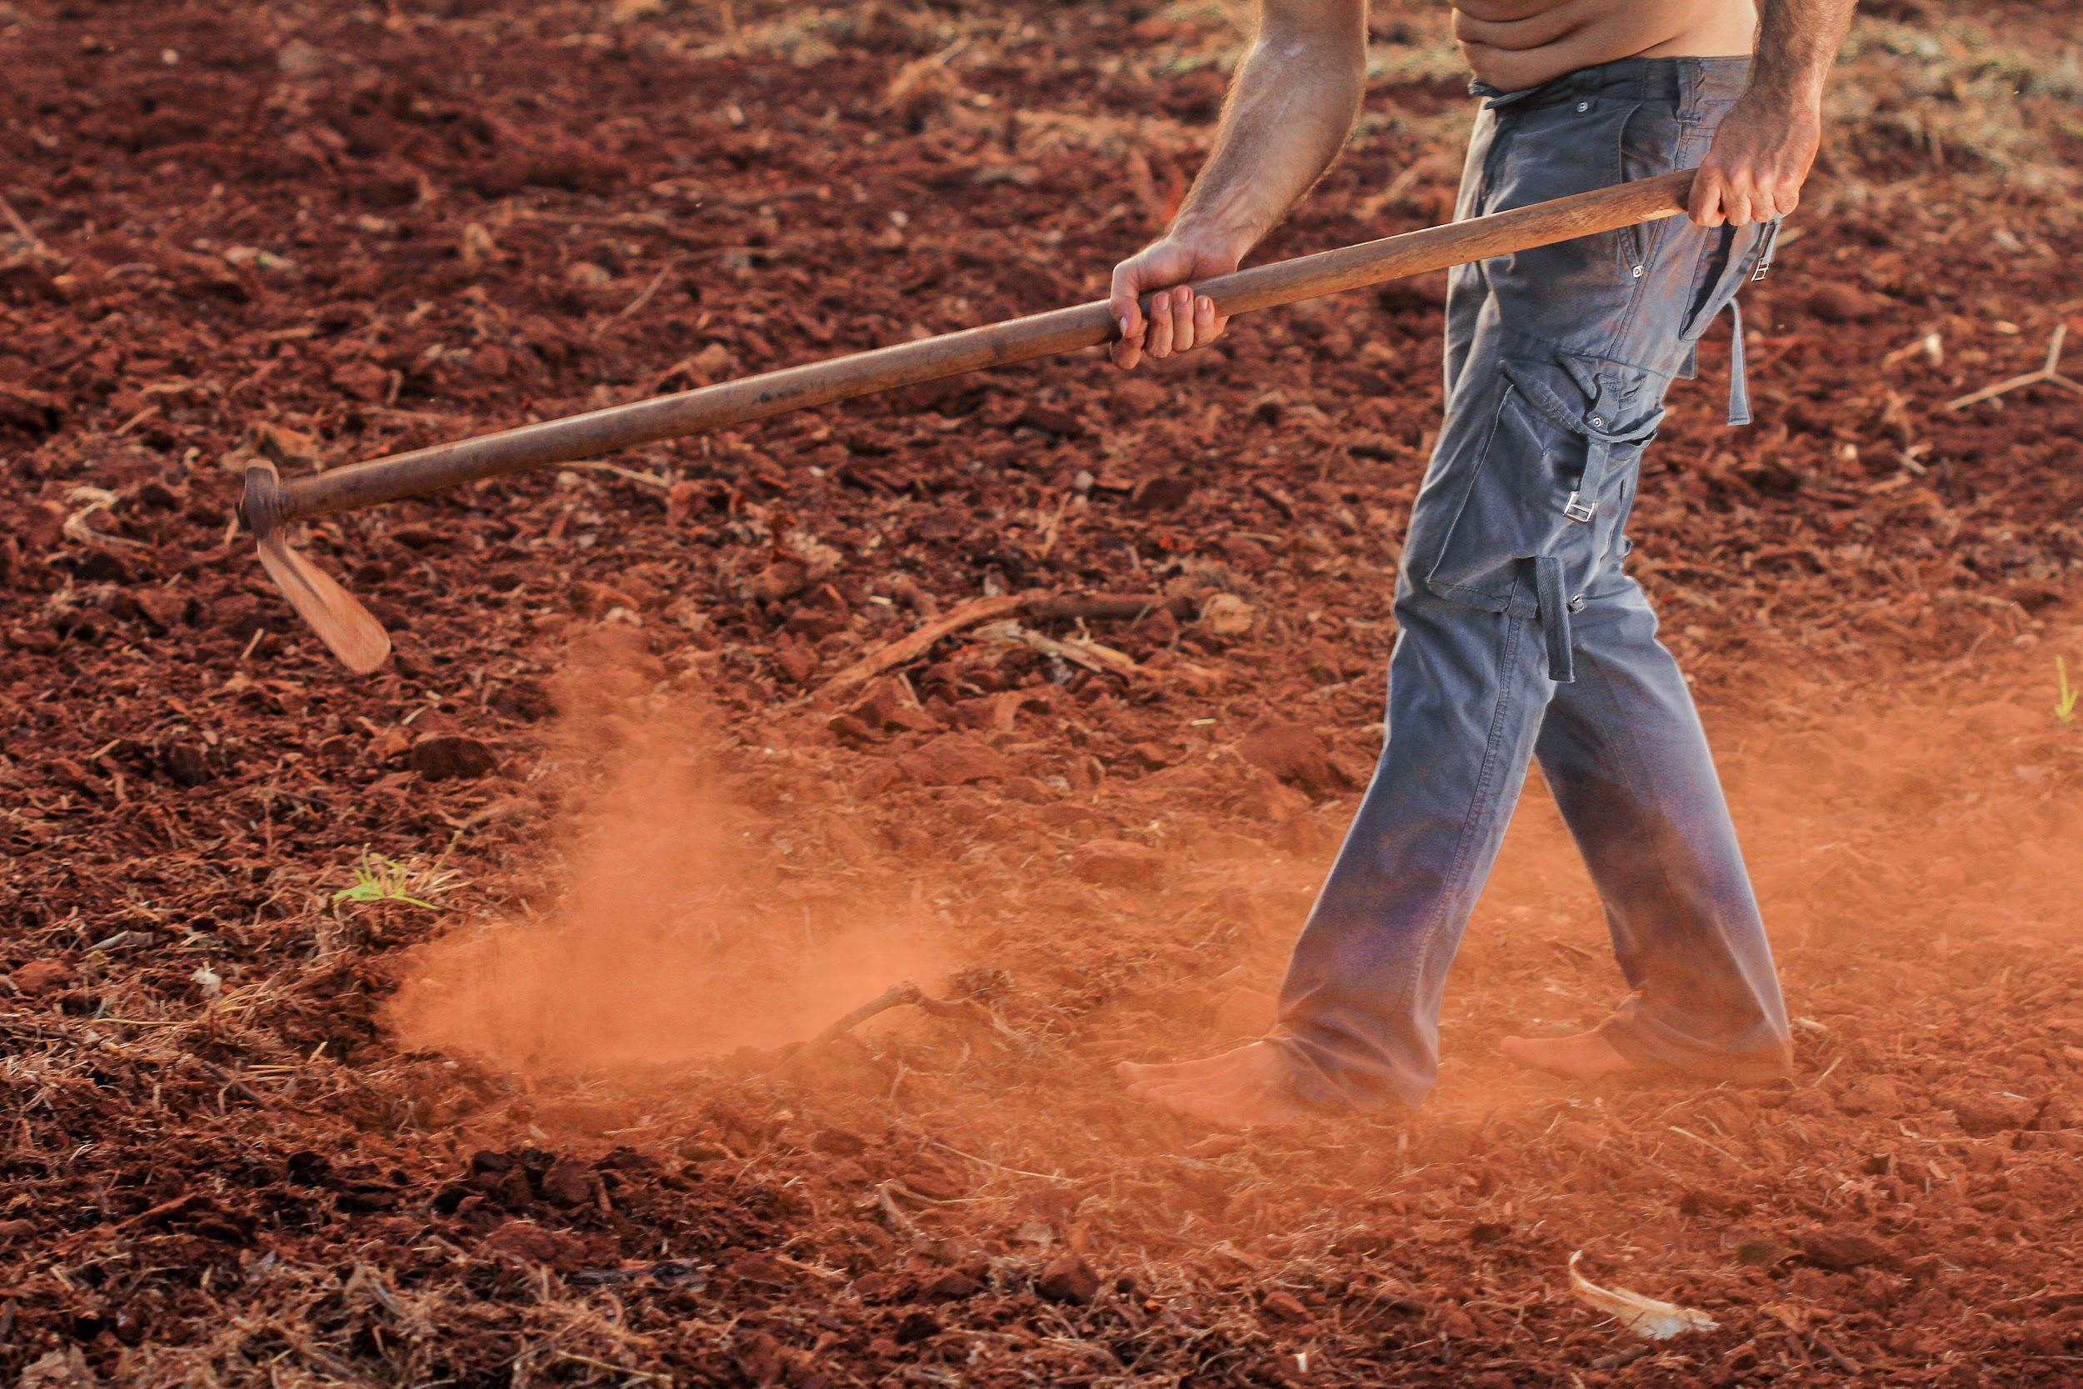
Farm Future
A Decision making call

Slide 2
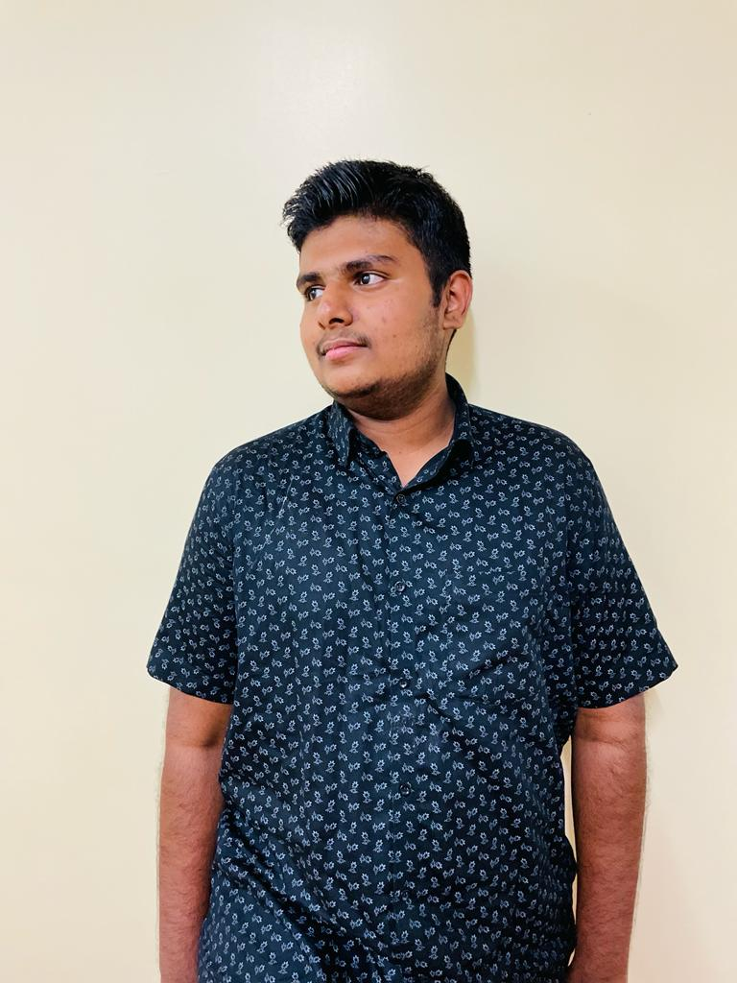
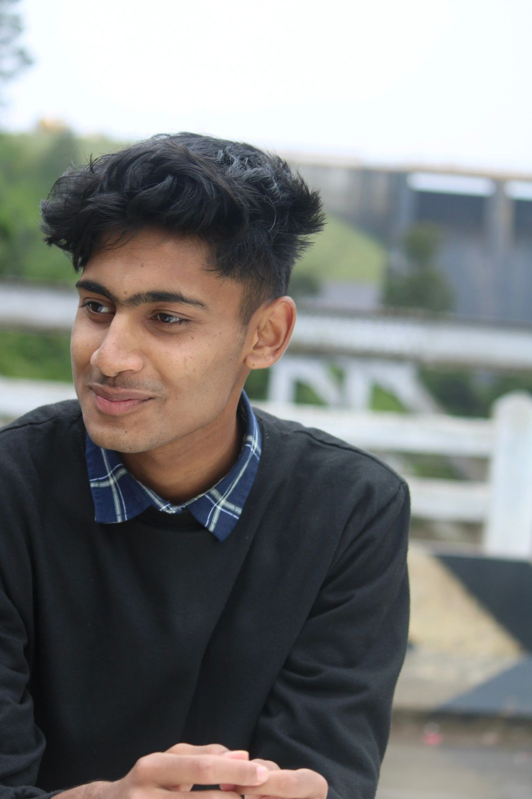
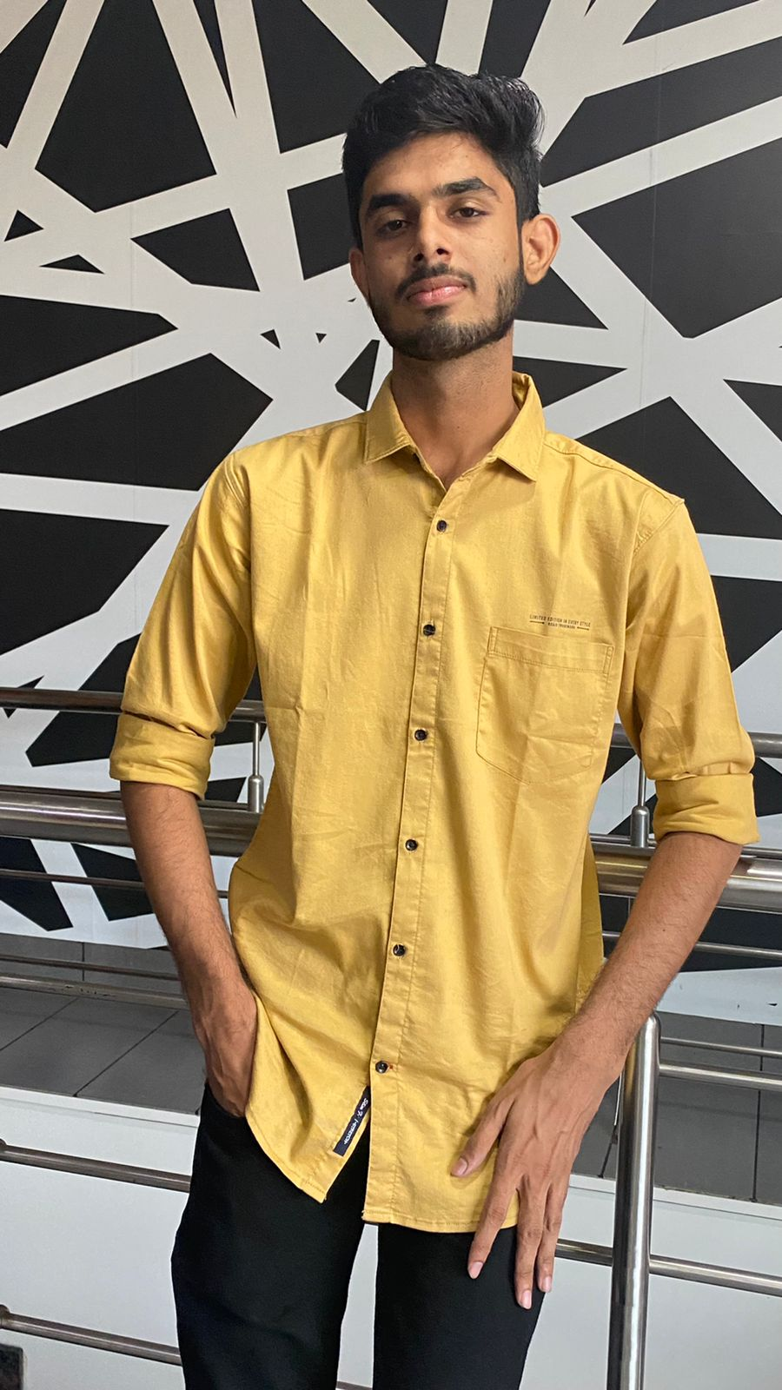
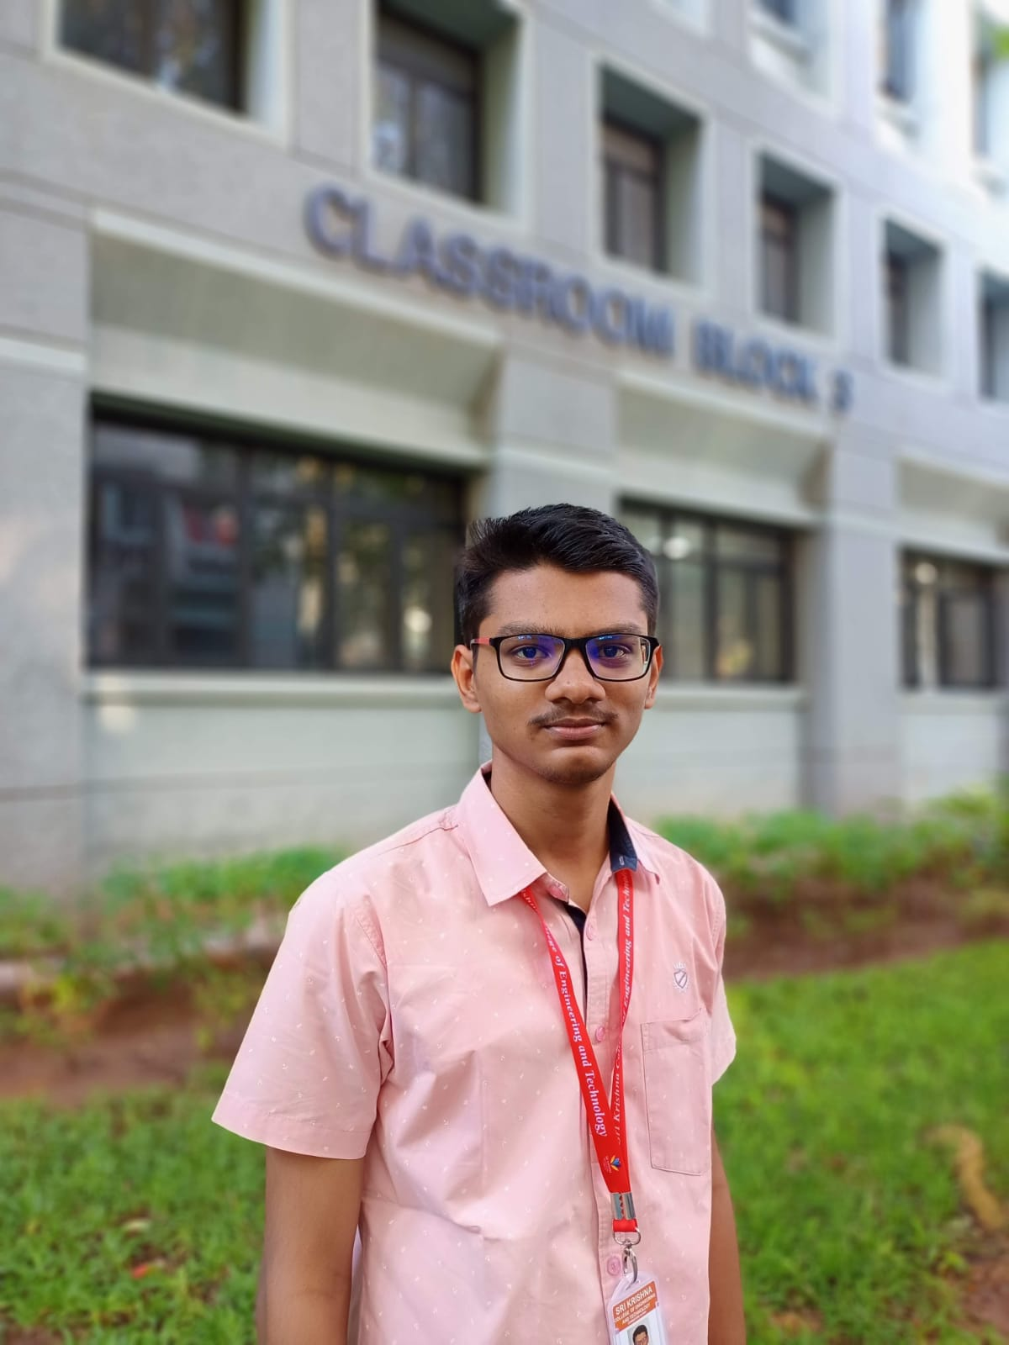

Broskis
Team Members
Team Leader:
Rishikesh. S
B.Tech IT
Suraj. S
B.Tech IT
Shyam Sundar. J
B.Tech IT
Sriram. M
B.Tech IT
Tharun Deeksith. K
B.Tech IT

Slide 3


Technology Stack:
React JS - Frontend
Supabase - Backend
Github Repository:
https://github.com/rishikesh2003/farm-future

Slide 4
Farmers Issue:
04
Government Schemes
Selling crops
The crops are sold at MSP prices
Various schemes are addressed
01
03
Hiring labourers
Crop diseases
Labours can be hired with less efforts
Crop diseases and it’s solutions
02

Slide 5
Uniqueness:
AI bot in Tamil.
Hiring Drone technicians.
Recommending seeds according to their region.
Easy hiring of labours.
Live crop price updates.
Notes:
z

Slide 6
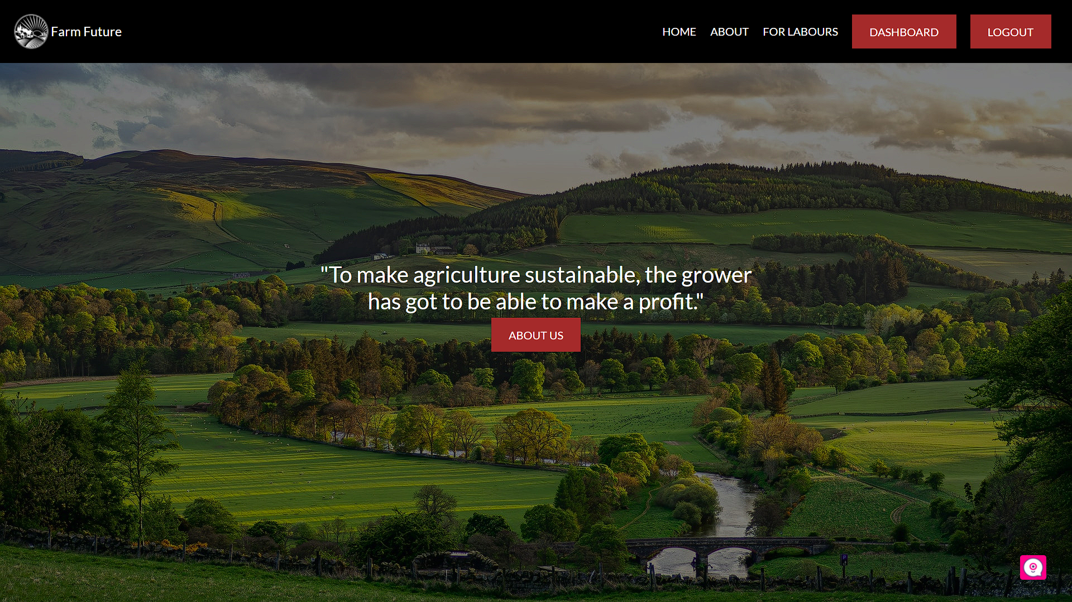
Prototype:

Slide 7
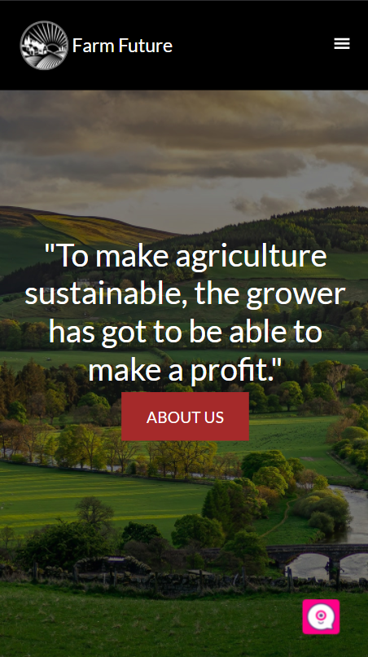
Thank you!

